Slide 1
An introduction to Azure SQL
The family of SQL cloud databases

Slide 2

Today’s data realities
02-01.01
3
What data do I have?
Data governance
Is it trustworthy?
2
Can people access the data needed to make the right decisions?
Analytics
1
How can I enable faster business insights?
Operational databases
What’s my compliance exposure?
Notes:
If there’s one thing that 2022 has taught us is that data is truly the strategic asset for businesses today.
During this time of uncertainty, one thing we’ve observed is that no business is immune to sudden changes. Navigating this new landscape requires a new level of agility for businesses to deal with sudden changes in our world.
And what we’ve observed is that those that can accelerate innovation and embrace their data as a strategic asset have fared better.
They have established the culture and capabilities needed to be more agile, able to anticipate and predict disruptions and pivot as needed to better serve their customers.
The stakes are high and an organization’s growth prospects ultimately depend on data at its core.
Doing this isn’t easy, given the realities of data today. The volume, variety and velocity of data are all accelerating dramatically, and the complexity of creating of an enterprise ‘knowledge graph’ can seem insurmountable. Today we generate data far faster than we are able to understand it
In fact, IDC predicts that by 2025, just 5 years from now, the world’s data will climb to 175 zettabytes. To put that in perspective, if you were to store that data in a stack of BluRay discs you’d be able to go to the moon and back 23 times!
Without the right people, processes and capabilities in place, it can be difficult to answer fundamental questions like:
What data do I have?
Is it trustworthy?
Are people getting the data they need to make the right decisions?
Are they getting it fast enough?
And are we managing data in a compliant way?...

Slide 3
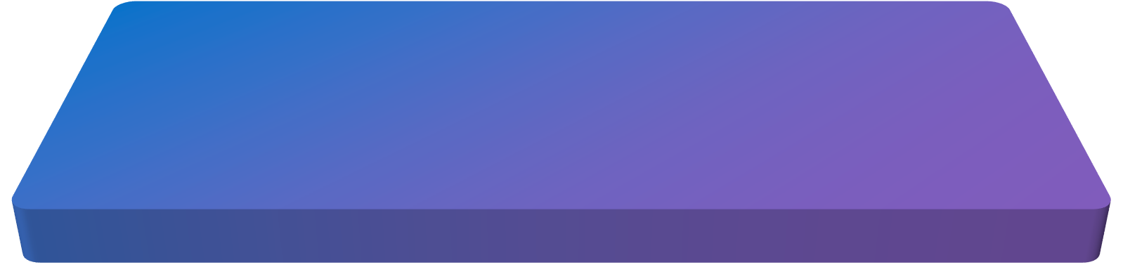
Introducing Microsoft Intelligent Data Platform
02-01.02
3
Data governance
2
Analytics
1
Operational databases
Microsoft Intelligent Data Platform
SQL Server • Azure SQL • Azure Cosmos DB • Azure Synapse Analytics
Power BI • Microsoft Purview • Azure AI
Operational databases | Analytics | Data governance
Notes:
Getting the right answers to these questions is possible when all your data assets are connected and managed in a cohesive fashion. This is why we announced the Microsoft Intelligent Data Platform, the leading cloud data platform that empowers organizations to invest more time creating value rather than integrating and managing their data estate.
The platform is made up of capabilities across databases, analytics and governance that, on their own, meet specific business needs and already bring many benefits but together helps easily evolve applications to include advanced analytics and intelligence. It is the integration of the products you are already using today to accelerate innovation and achieve agility, across our cloud, as well as others
We want to remove key points of friction between your databases and analytics systems while ensuring your full data estate can be automatically mapped and governed
Organizations can analyze large volumes of operational data in near real-time with no extraction, transformation, or loading (ETL) pipelines, and no performance impact on transactional workloads
And anyone in the organization, whether they’re a data scientist, data analyst or a domain expert, can access, analyze, and share data
This is the state we are all aiming for is where we can:
Accelerate innovation, Focus on what matters most – your business. Free resources to create frictionless customer experiences, transform products and empower employees.
Achieve agility, Pivot faster to respond to dynamic environments with an integrated data platform that adapts to your needs with hybrid and multi cloud capabilities. Build how you want, deploy where you want and gain fast, continuous insights.
Build on a trusted platform, Deliver data-powered experiences with the security and privacy controls required to innovate with confidence. Azure provides the most comprehensive protection for your valuable business data.

Slide 4
Transform with the Microsoft Cloud
02-04.05
2
Microsoft Cloud
Dynamics 365 • Microsoft 365 Power Platform
1
2
3
Microsoft Intelligent Data Platform
SQL Server • Azure SQL • Azure Cosmos DB • Azure Synapse Analytics
Power BI • Microsoft Purview • Azure AI
Operational databases
Analytics
Data governance
Operational databases | Analytics | Data governance
Notes:
We're also integrating The Intelligent Data Platform with the rest of the Microsoft Cloud, for enabling richer data experiences for business users of Microsoft 365 and Dynamics 365 and Power Platform.
The first step for a successful digital transformation is often data modernization. Migrating and modernizing your databases allows you to focus on your application, not your database. You no longer have to worry about scaling your applications to meet high demand, security and management is made simple, and you’re always up to date with the latest and greatest database features, irrespective of whether you prefer proprietary or open source databases.

Slide 5
Industry Findings Predict Continued Migration and Modernization Momentum
27%
59%
72%
projected growth in cloud-based IT spend in 2021
Of organizations responded that migrating more workloads to the cloud is a top Cloud Initiative for 2021*
of organizations reported industry’s pace of transformation has been accelerating as a result of the pandemic
90%
23%
80%
of existing apps will still be in use, cloud modernization top benefit
Growth in end user spend on public cloud computing to $332B**
of enterprises will have the mechanism in place by the end of 2021 to shift to cloud-centric infrastructure and applications, 2X as fast as before the pandemic
Source: Gartner reports and public articles | *Source: Flexera State of the cloud 2021 | **Gartner Press Release: Gartner Forecasts Worldwide Public Cloud End-User Spending to Grow 23% in 2021

Slide 6
Migration and modernization triggers
Cash flow challenges
Cybersecurity threats
Datacenter contract expiry
Budget and resource constraints
Migration
Modernization
Rapidly scale web apps and infrastructure
Enabling remote work
Faster time to market
Drive Innovation
Unlocking more cost optimization
Notes:
These are the typical triggers that are making customers look at migrating or modernizing their workloads on the cloud.
Cash flow challenges – This includes cash flow challenges not just for our customers, but also their entire ecosystem (e.g., suppliers, distributors, end customers).
Cybersecurity threats – Customers are feeling more vulnerable to attackers, their defenses are down
Scarce IT budgets/resources – Customers are reporting the need to free up IT $s to invest into other parts of the business that may need it more
Ability to meet surge demand – Several industries such as healthcare, retail are seeing a surge in demand. They are finding that their existing systems and solutions just can’t keep up.
Business continuity – Customers have real concerns about their day to day operations being interrupted (e.g., network connectivity, data loss)
Datacenter contract expiry – Many customers we speak to are viewing contract expiry as an inflection point to consider cloud migrations (“is it worth running my own given resource/cash flow challenges”?)

Slide 7
Why should customers migrate and modernize to Azure?
Migration
Modernization
Enterprise-grade Infrastructure for less
Innovate faster with a fully managed platform
Move on your terms with hybrid flexibility
Protect your most valuable assets with trusted cloud security every step of the way
Comprehensive programs to help you move with confidence
Notes:
Pay less, use best-in-class infrastructure:
Future proof your business and IT – be it remote workforce productivity or on-demand scale – by moving to best-in-class, highly resilient cloud infrastructure that costs up to 5x less than AWS
Innovate faster by modernizing your applications and data:
Focus on modernizing your application and workload portfolio to meet business demands of today and tomorrow. Use a highly productive platform and fully managed services – we take care of the operational work for you
Move on your terms with hybrid flexibility:
We get that your investments will span cloud and on-premises for the foreseeable future. Azure hybrid cloud solutions help you reuse, manage, and govern your assets consistently across hybrid environments as you move to the cloud (and beyond) - on your terms.
Protect your valuable assets with trusted cloud security:
We have your back. Get security from the ground up – backed by experts and proactive compliance. With AI-infused security intelligence, we help you detect and protect your investments against rapidly evolving cybersecurity threats.

Slide 8
Be future-ready with Azure
A.I.
Intelligent by default
Scale
Limitless
Hybrid
Operational freedom
Security
Always a step ahead
Notes:
Microsoft Azure is the cloud that lets you turn ideas into solutions with more than 100 services to build, deploy, and manage applications—in the cloud, on-premises, and at the edge—using the tools and frameworks of your choice. Our track record of continuous innovation supports your development today and your visions for tomorrow. Over the past year, we’ve launched over 1000 capabilities on the platform, helping our customers be future-ready. The cloud is moving fast – every week a new technology is coming out. So it’s about meeting new capabilities now and investing in those on the horizon.
In the world of data, we are committed to empowering organizations to build on their terms with flexibility and choice, and that includes the freedom to operate anywhere.
Nothing is more important than trust, particularly when you’re talking about the cloud. We spend $1B a year on cyber security with 3500 cyber security engineers who are constantly monitoring your data for threats. We’ve invested ahead of the curve in layers of security with built-in controls to protect your data and close the gaps that attackers can exploit. Trust your workloads to Azure, built upon the most secure cloud with the broadest compliance coverage.
Break through the resource constraints of modern application development with limitless scale that goes far beyond other cloud providers.
Modernize existing apps or build new apps on Azure with built-in, AI-based technologies that power new customer experiences.
Azure can help you innovate today, tomorrow, and in the future. We are constantly providing capabilities that can help meet your needs.

Slide 9
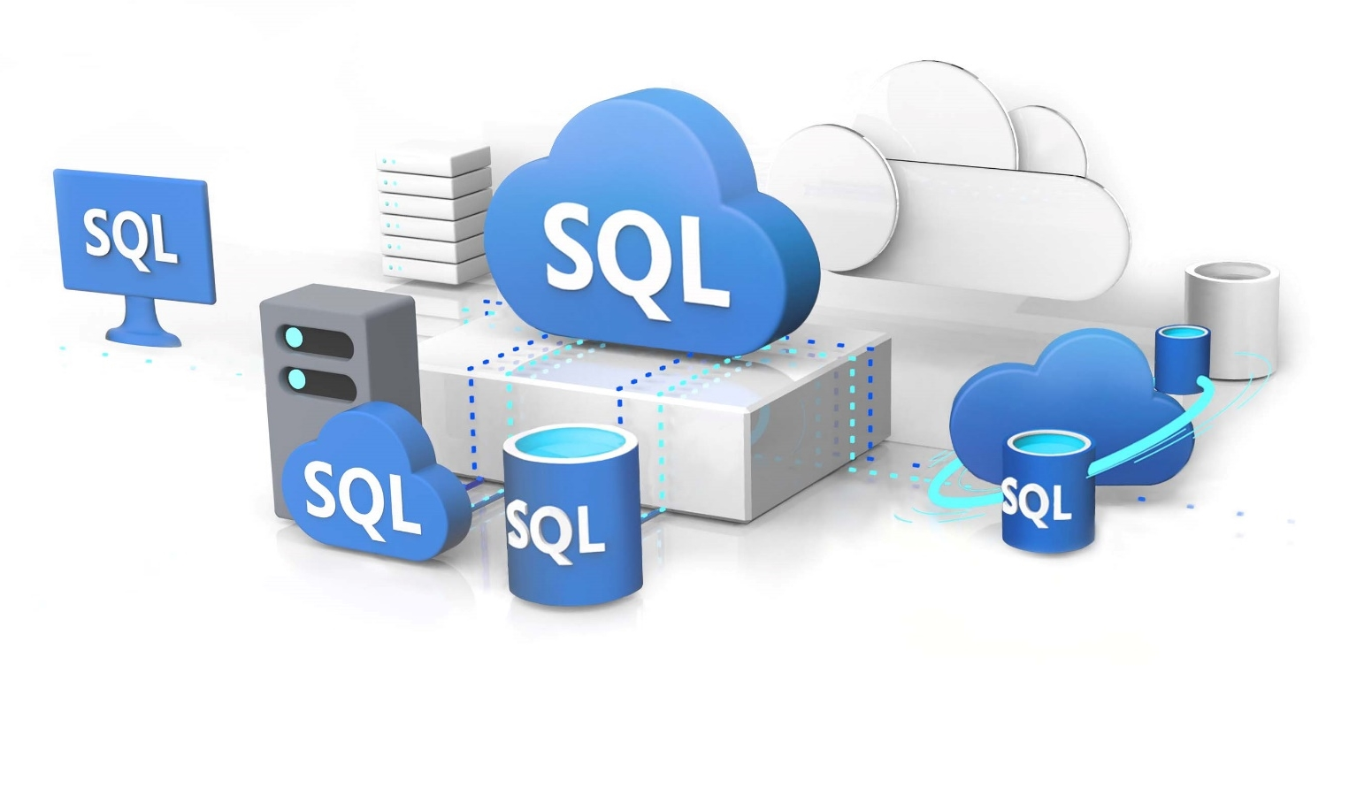
Introducing Azure SQL
The family of SQL cloud databases
Providing flexible options for
Migration
Modernization
Development
Notes:
The Azure SQL family of SQL cloud databases, part of the Microsoft Intelligent Data Platform, provides flexible options for application migration, modernization, and development
Intelligent and secure Azure SQL database services make it easy to:
Migrate your SQL workloads
Modernize your existing SQL Server applications
Support modern cloud applications
Use your existing SQL skills in the cloud or at the edge with the same SQL Server engine
Keep making the most of your current license investments

Slide 10



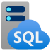
Azure SQL
The family of SQL cloud to edge databases
SQL Server on Azure Virtual Machines
Azure SQL Managed Instance
Azure SQL Database
Azure SQL Edge
Best for lift and shift and/or workloads requiring OS-level access
Best for modernizing existing apps
Best for supporting modern cloud apps
Best for extending apps to IoT edge
Infrastructure-as-a-Service
Platform-as-a-Service
Edge Computing
Azure SQL enabled by Azure Arc
Run Azure SQL on premises and in multicloud environments
Azure is the cloud that knows SQL Server best
Notes:
Azure SQL is a family of fully-managed, secure and intelligent SQL database services. Azure offers the widest range of deployment options for SQL from edge to cloud. With Azure SQL, you can rehost SQL workloads on SQL Server on Azure Virtual Machines, modernize existing applications with Azure SQL Managed Instance and support modern cloud applications with Azure SQL Database and Azure SQL Edge.
Azure SQL is built upon the same SQL Server engine, so you can migrate applications with ease and continue to use the tools, languages and resources you’re familiar with. Your skills and experience transfer to the cloud and edge, so you can do even more with what you already have.
The services within Azure SQL support a variety of scenarios:
SQL Server on Azure Virtual Machines
Lift-and-shift your SQL workloads with ease and maintain with 100% SQL Server compatibility and operating system-level access
Azure SQL Managed Instance
Modernize your existing SQL Server applications at scale with an intelligent fully managed service
Azure SQL Database
Support modern cloud applications on an intelligent, managed service that includes serverless compute
Azure SQL Edge
Run IoT edge compute with a SQL database optimized with data streaming, time series, and AI capabilities built-in
SQL Server on Azure VMs and SQL Managed Instance are also now Azure Arc enabled, allowing you to run these services on the infrastructure of your choice, when a hybrid approach is required.

Slide 11
Azure SQL is the best choice for SQL Server workloads
Run any workload anywhere on the industry-leading SQL Server engine
Fully-managed and always up to date
Use your existing SQL experience in the cloud
Save with the lowest total cost of ownership
Protect your data with built-in, real-time intelligent security
Be more productive with AI-powered features that automate tasks and optimize performance for you
Build on what you know with a consistent code base and deploy it anywhere from edge to cloud
Get more cloud for less with leading price-performance and savings up to 85% off pay-as-you-go rates with Azure Hybrid Benefit.
Secure your data with layers of protection, built-in controls, intelligent threat detection, and the broadest set of compliance offerings
The only cloud with evergreen SQL
Software is continually updated and never requires patches
Notes:
Azure SQL is the best choice for SQL Server workloads, with each of the services within the family built upon the same SQL Server engine you’re already familiar with.
Azure SQL:
Is Fully-managed and always up to date, allowing you to spend more time innovating and less time patching, updating, and backing up your databases. Azure is the only cloud with evergreen SQL that automatically applies the latest updates and patches so that your databases are always up to date—eliminating end-of-support hassles.
Let’s you use your existing SQL experience in the cloud. Built on the same SQL Server technology that you’re already familiar with, so you don’t need to relearn your SQL skills when you make the move. Develop your application once using your existing SQL skills and deploy it on any Azure SQL cloud database on Azure.
Helps you save with the lowest total cost of ownership. Get industry-leading pricing and maximize your existing on-premises investments when you migrate your SQL Server databases to Azure:
Save up to 85 percent¹ off pay-as-you-go pricing when you bring your existing SQL Server licenses to Azure with Azure Hybrid Benefit.
Get more cloud for less when you combine Azure Hybrid Benefit with reservation pricing.
Qualify for discounted rates to support your ongoing development and testing on Azure.
Spend less time monitoring your workloads with a single portal that lets you view all of your Azure SQL databases, virtual machines, pools, and instances in one place.
Protects your investment with built-in, intelligent security. Remediate potential threats in real-time with intelligent threat detection and proactive vulnerability assessment alerts. Get industry-leading, multi-layered protection with built-in security controls including T-SQL, authentication, networking, and key management. Take advantage of the most comprehensive compliance coverage of any cloud database service.

Slide 12

Azure SQL provides more price-performance value
Azure SQL Managed Instance vs SQL Server on AWS RDS
MSOLTPE Benchmark
April 2022
SQL Server on Azure VM vs SQL Server on AWS EC2
Transactional Field Test Benchmark
April 2022
93% LESS
31% LESS
Price/Transactions per second (tps)
Price/Transaction
Price performance comparison. Lower is better.
Includes Azure Hybrid Benefit
Price performance comparison. Lower is better.
Includes Azure Hybrid Benefit and 3-yr commitment
Source: Principled Technologies
Source: GigaOm
Notes:
But, not only can you do more with what you have, but you can also get more for performance for your money.
Azure SQL provides more value through leading price-performance. A recent report from Principled Technologies, an independent research firm, concluded the following:
Azure SQL Database meets your mission-critical requirements up to 5 time faster while costing up to 93% less than SQL Server on AWS RDS.¹
SQL Server on Azure Virtual Machines has up to 42% higher transactions per second and costs up to 31% less than SQL Server on AWS EC2.²
¹ Price-performance claims based on data from a study commissioned by Microsoft and conducted by Principled Technologies in April 2022. The study compared performance and price performance between a 16 vCore, 64 vCore and 80 vCore Azure SQL Managed Instance using premium-series hardware on the business-critical service tier and the db.m6i.32xlarge, db.r5b.4xlarge and db.r5b.16xlarge offerings for Amazon Web Services Relational Database Service (AWS RDS) on SQL Server. Benchmark data is taken from a Principled Technologies report using recognized standards, HammerDB TPROC-C, HammerDB TPROC-H and Microsoft MSOLTPE, a workload derived from TPC-E. The MSOLTPE is derived from the TPC-E benchmark and as such is not comparable to published TPC-E results, as MSOLTPE results do not comply with the TPC-E Specification. The results are based on a mixture of read-only and update intensive transactions that simulate activities found in complex OLTP and analytics application environments. Price-performance is calculated by Principled Technologies as the cost of running the cloud platform continuously divided by transactions per minute or per second throughput, based upon the standard. Prices are based on publicly available US pricing in South Central US for Azure SQL Managed Instance and US East for AWS RDS as of April 2022 and incorporates Azure Hybrid Benefit for SQL Server, excluding Software Assurance and support costs. Performance and price-performance results are based upon the configurations detailed in the Principled Technologies report. Actual results and prices may vary based on configuration and region.
² Price-performance claims based on data from a study commissioned by Microsoft and conducted by GigaOm in April 2022. The study compared price performance between SQL Server 2019 Enterprise edition on Windows Server 2022 in Azure E32bds_v5 instance type with P30 Premium SSD disks and SQL Server 2019 Enterprise Edition on Windows Server 2022 in Amazon Web Services Elastic Cloud Compute instance type r5b.8xlarge with General Purpose (gp3) volumes. Benchmark data is taken from two tests:
The GigaOm Transactional Field Test derived from a recognized industry standard, TPC Benchmark™ E (TPC-E).The Field Test does not implement the full TPC-E benchmark and as such is not comparable to any published TPC-E benchmarks.
The GigaOm Analytics Field test derived from the TPC-H Benchmark. The field test does not implement the full TPC-H benchmark and as such is not comparable to any published TPC_H benchmarks.
Prices are based on publicly available US pricing in North Central US for SQL Server on Azure Virtual Machines and Oregon for AWS EC2 as of April 2022. The pricing incorporates three-year reservations for Azure and AWS compute pricing, and Azure Hybrid Benefit for SQL Server and Windows Server, and License Mobility for SQL Server in AWS, excluding Software Assurance and support costs. Actual results and prices may vary based on configuration and region.

Slide 13






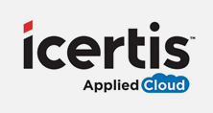

Key use cases
Rehost on-premises workloads to Linux-based SQL Server virtual machines
Modernize in the cloud for efficient business operations
Optimize costs of unpredictable and intermittent workloads
Simplify and secure IoT data with hybrid or edge computing




Using Microsoft SQL Server 2017 on Azure, we’ve reduced the effort and cost of running our platform while increasing our agility and speed of deployment—and optimizing performance.”
Matteo Lazzari, Product Owner and CloudOps ERP Product Team Lead
With Azure, we didn’t have to reinvent everything. We could manage the database, its scale, backups, and redundancy right out of the box.”
Paul Hill, Principal Cloud Architect
We’ve realized three major benefits. One: We only pay for what we use. Two: relying on serverless automatic scaling instead of our own home-grown solution frees more time for innovation. And three: It helps our customers always get the right performance levels they need, day or night.”
Purna Rao, Senior DevOps Architect
We can remotely deploy Azure SQL Edge and gain SQL capabilities almost instantly. This is a game-changer, opening up possibilities of having multiple dedicated instances, all maintained remotely. ”
Pim Peereboom, Global Project Manager, Integrated Marine Management
Notes:
Let’s look at some of our customers who have modernized their workloads to Azure or are building new applications - and reaping the benefits:
TeamSystem (https://customers.microsoft.com/en-us/story/809018-teamsystem-partner-professional-services-sql-server-azure-virtual-machines)
Situation:
TeamSystem’s heterogenous technology stack increased costs and dev complexities.
Solution:
TeamSystem migrated their on-premises technology stack to SQL Server on Azure Virtual Machines, using Linux-based Azure Ev3 VMs to deliver high-performance while minimizing costs.
Impact:
By using Microsoft SQL Server 2017 on Linux-based Azure virtual machines, TeamSystem has reduced costs and increased agility and deployment speeds—all while optimizing database performance.
Schneider Electric (https://customers.microsoft.com/en-us/story/862040-schneider-electric-azure-energy)
Situation:
Schneider Electric wanted to simplify its application infrastructure to reduce costs, innovate faster, and help customers optimize energy performance. It hoped to move a critical application to Microsoft Azure without having to rearchitect it.
Solution:
The company adopted several key Azure platform as a service offerings, including Azure App Service, Azure DevOps, Azure SQL Database, and Azure Monitor, to migrate and modernize the application in its entirety.
Impact:
With a much simpler infrastructure to manage, Schneider Electric saved time and money. Now, it can innovate and deploy new features faster without worrying about scale, helping it deliver even more value to its customers.
ICERTIS (https://customers.microsoft.com/en-us/story/781602-icertis-partner-professional-services-azure)
Situation:
Icertis, which provides industry-leading cloud-based contract management software, experienced spikes in customer workloads. It was challenging to predict demand and quickly rescale compute power to meet it—driving up costs and complexity.
Solution:
With the Microsoft Azure SQL Database serverless compute tier, Icertis can automate almost instant rescaling of database and compute resources to meet customer workload demands. It only pays for the power its customers need, and DevOps employees now focus on high-value initiatives.
Impact:
Icertis has reduced individual database costs by up to 70 percent, reduced operational complexity, and improved service fidelity, performance, and availability.
FUGRO (https://aka.ms/sqledge-fugro/)
Situation:
Fugro, a leading global geo-data specialist, manages data across remote and distributed locations. Issues with connectivity and latency were preventing them from driving real-time insights, and required that they store exploration data on the ship which could span 100s of GBs.
Solution:
Fugro deployed Azure IoT Edge and Azure SQL Edge to run edge-cloud workloads locally on their vessels enabling:
Analytics while at sea without network connectivity.
Ability to develop once and deploy anywhere
Ability to use a consistent model for centralized analytics in the cloud
Impact:
Fugro converted a legacy system to use Azure SQL Edge in one week with one developer and has reduced the time needed to process and deliver monthly data reports from offshore locations to client dashboards from two weeks to eight minutes.

Slide 14
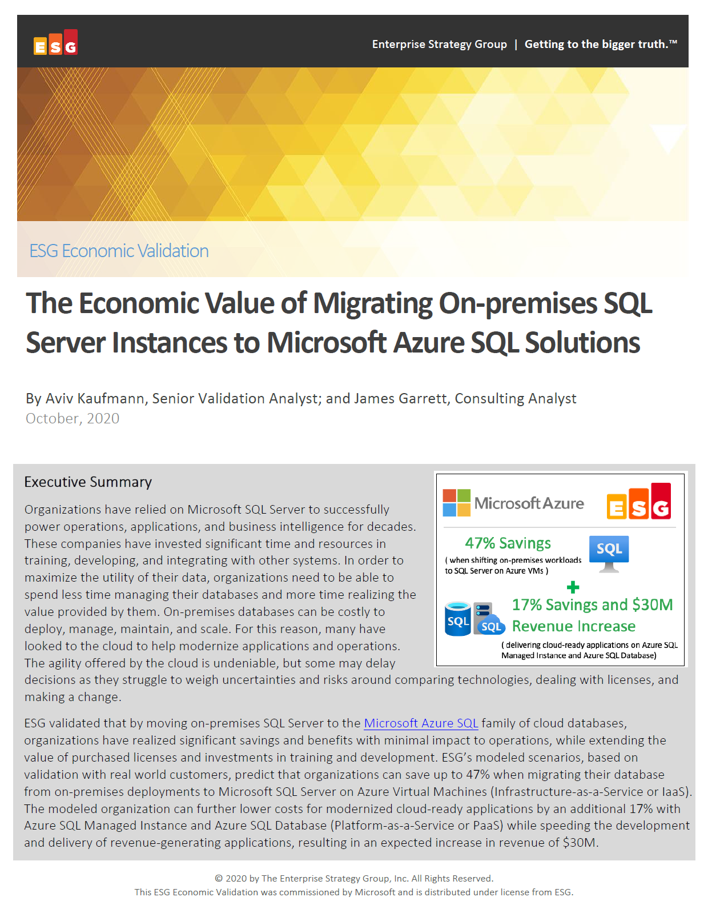
Migrate to IaaS, continue to PaaS and boost your ROI
Enterprise Strategy Group examined potential cost savings and business benefits enterprises would achieve from migrating on-premises workloads to Azure SQL, first to IaaS then to PaaS.
Modernizing on Azure SQL yields even greater benefits…
Key report benefits and findings¹
+17%
Additional cost savings on Azure SQL managed databases vs Azure SQL VMs
53%
Lower cost of application administration
Up to 47%
Cost savings on Azure SQL VMs vs on-premises SQL Server
90%
Lower cost of systems administration
+$30M
Additional revenue due to faster time to market
¹ Results are based on interviewed customers. “The Economic Value of Migration On-premises SQL Server Instances to Microsoft Azure SQL Solutions,” a commissioned study conducted by The Enterprise Strategy Group on behalf of Microsoft, October 2020.
Notes:
The previous stories are just a sample of the types of scenarios that Azure SQL supports – and the benefits customers have experienced when choosing Azure SQL.
Enterprise Strategy Group recently published a commissioned study that looked at the potential savings and operational benefits of migrating from on-premises to Azure SQL, first to IaaS and then continuing to PaaS.
ESG saw that modernizing on Azure SQL’s managed databases provided an incremental +17% cost savings vs Azure SQL VMs, but also significant reductions in app and systems administration costs.
The benefits of fully-managed services are compelling, but ultimately you need to decide which Azure SQL options are right for you.

Slide 15
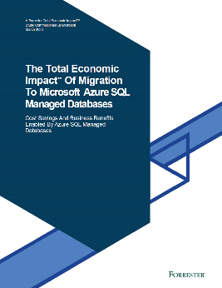
Modernize directly onto PaaS for maximum benefit
Forrester Consulting examined potential cost savings and business benefits enterprises would achieve from migrating on-premises workloads to fully managed Azure SQL Database and Azure SQL Managed Instance
Key report benefits and findings¹
25%
Increase in productivity for IT teams
40%
Improvement in productivity for in-house DBAs
$10.9M
Savings from avoided hardware, network, storage and ongoing maintenance costs
238% Total ROI
3 years after initial investment & migration to Azure SQL’s managed databases
“We needed our DBAs and IT staff to focus on improving the customer experience and other things critical to our company, not on patching databases and trying to manage our own infrastructure.”
Chief architect, financial services company
Head of development, technology company
3 months or less
Payback post migration
¹ Results are for a composite organization based on interviewed customers. “The Total Economic ImpactTM of Migration to Microsoft Azure SQL Managed Databases,” a commissioned study conducted by Forrester Consulting on behalf of Microsoft, March 2020.
Notes:
Microsoft commissioned Forrester Consulting to conduct a Total Economic Impact™ study in March 2020 to examine potential cost savings and business benefits enterprises would achieve from migrating on-premises workloads to Azure SQL Database and Azure SQL Managed Instance.
Three years after the initial investment and migration, organizations realized up to 238% return on investment and saw significant productivity improvements across their IT and in-house DBA teams.
Choose Azure SQL and write your own success story.

Slide 16
SQL Managed Instance is Azure Arc enabled
Key Benefits
Some scenarios may require a hybrid approach:
Always current
Access the latest Azure features and capabilities for on-premises data workloads
Data latency
Regulations
Distributed compute
Multi-cloud
Elastic scale
Dynamically scale up or out your data workloads based on capacity
Bring Azure innovation and cloud benefits on-premises, multi-cloud, and at the edge with Azure Arc enabled SQL Managed Instance
“I really like the SQL version control, which helps reduce the time that senior administrators must spend upgrading all those different versions.”
Unified management
Gain a single view of your data across on-premises and cloud environments
Kristina Melo, IT Manager, Ferguson Enterprises
Notes:
When connectivity, data sovereignty, or regulatory concerns drive a hybrid approach. Azure SQL has you covered.
SQL Managed Instance is now Azure Arc-enabled. Bring Azure data services to on-premises, multicloud, and edge environments.
Run Azure data services on-premises, at the edge, and in multicloud environments using Kubernetes on the infrastructure of your choice. Get the latest Azure innovations, elastic scale, and unified management for data workloads with or without direct cloud connection.

Slide 17
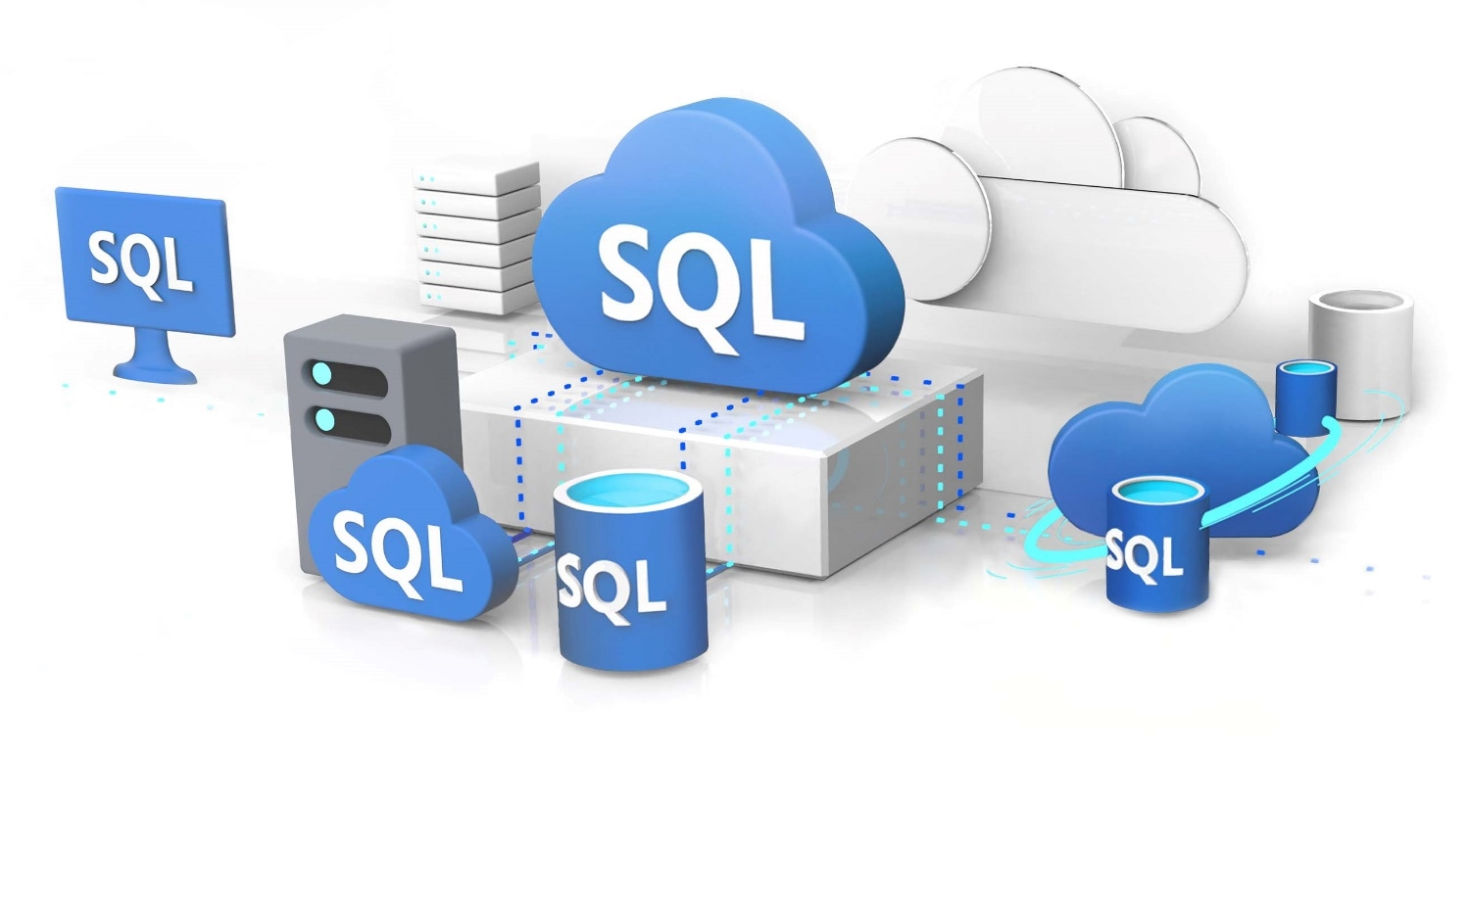
Choose the right Azure SQL database service for you
Let us help point you in the right direction in three easy steps
1. Visit our interactive tool
2. Answer a few simple questions
3. Receive a service recommendation
Try it at aka.ms/choose_your_AzureSQL_database

Slide 18

Get started today!
Web pages
Azure SQL family
SQL Server on Azure Virtual Machines
Azure SQL Managed Instance
Azure SQL Database
Azure SQL Edge
Choose Your Azure SQL database tool
Azure Hybrid Benefit for SQL Server
Azure Database Migration Service
Migration guide
Other Resources – infographics
Infographic: Azure SQL family
Azure SQL Jumpstart Guide
Infographic: Forrester Consulting Total Economic ImpactTM study
3rd party studies
ESG Economic Value report on migrating to Azure SQL
Principled Technologies price-performance study
Forrester Consulting Total Economic Impact™ study

Slide 19
Closing slide

Slide 20
Appendix

Slide 21
Azure SQL
Azure SQL Database and Azure SQL Managed Instance
Streamline app modernization
Hyperscale demanding workloads
Optimize price-performance with serverless compute
Save with the best total cost of ownership
Accelerate app modernization with minimal code changes on the only cloud with evergreen SQL
Rapidly adapt to changing requirements with Hyperscale storage up to 100 TB
Build modern apps your way with flexible compute options that include auto-scaling serverless. Pay only for what you use.
Meet mission critical requirements while costing up to 86% less than the competition
Built-in AI
Advanced data security
Always On reliability
Optimizes performance and durability for you
Secure your data with layers of protection, built-in controls and leading compliance
Maximize uptime with built-in high availability and an industry-leading availability SLA up to 99.995%
Notes:
Azure SQL Database and Azure SQL Managed Instance are fully-managed services that are always up to date with the latest features, updates and patches so you can focus more on developing great experiences for your customers instead of managing infrastructure and software. Our most recent investments provide the highest SQL Server on-premises application compatibility, remove the limits to application growth and help you cost-optimize your compute spend.
With Azure SQL Managed Instance, we’re streamlining app modernization by providing the full SQL Server programming surface area in the cloud, eliminating the need for code changes and providing the tools and environment DBAs are familiar with.
Break through the resource limitations that can affect your application’s performance. Azure SQL Database Hyperscale adapts to changing requirements by rapidly scaling storage up to 100 TB. Flexible, cloud native architecture allows storage to grow as needed and enables nearly instantaneous backups and fast database restores in minutes—regardless of the size of the data operation.
Optimize costs and build modern apps your way with flexible compute options that include serverless. Azure SQL Database serverless simplifies performance management and helps developers focus on building apps faster and more efficiently with compute resources that automatically scale based on workload demand. SQL Database serverless is best for scenarios where usage is intermittent and unpredictable and you only pay for compute resources you use on a per-second basis, optimizing overall price-performance.
Switch to Azure SQL Database and save with the best total cost of ownership. Azure SQL Database meets your mission-critical requirements while costing up to 86 percent less than the competition. Unique offers like Azure Hybrid Benefit for SQL Server maximize the value from your current licensing investments. Use your SQL Server licenses with Software Assurance and save up to 55 percent over pay-as-you-go pricing.
Our managed services are all built on a foundation of trust, reliability and productivity, securing your data with layers of protection and built-in controls, maximizing uptime with up to 99.995% availability and optimizing performance and durability on your behalf.

Slide 22
Azure SQL
SQL Server on Azure Virtual Machines
Save with the best total cost of ownership
Rehost onto an industry-leading database
Experience high performance on any operating system
Protect your data and ease maintenance
Pay up to 84% less than AWS
Built on an enterprise-grade, unified data platform
High performance virtual machines for SQL Server on Linux and Windows
Automatic security updates and built-in availability
Get the performance, security, and analytics of SQL Server backed by the flexibility and hybrid connectivity of Azure

Slide 23



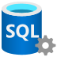
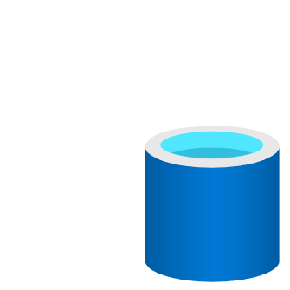
Azure SQL
Azure SQL Edge
Time series, data streaming and AI
Native data movement to Azure
Your choice of platform
Unparalleled
performance & security
Simplified pricing for IoT
Stream, store, and analyze IoT data and apply business logic using built-in AI & ML capabilities
Consistent app development
and management from cloud
to data center to edge
Run SQL on your choice of platform Including ARM 64 and x64 architecture
Flexible high availability and industry-leading data protection and security tools
$10 per month/device or as low as $60 per year/device for a 3-year commitment*.
Develop once
Deploy anywhere
Consistent application development and management experience
Simplify your architecture from ground to cloud to edge
SQL
Azure SQL
SQL Server
Azure SQL Edge
Optimized for IoT edge gateways and devices, this small-but-mighty SQL engine enables real-time insights, in connected, disconnected, or hybrid environments
* Terms and conditions apply. See Azure.com for details.
Notes:
Azure SQL Edge extends the industry-leading performance and security of Microsoft SQL engine to the intelligent edge.
Optimized for IoT gateways and devices, this small-footprint container provides real-time insights with built-in streaming, storage, and support for AI. Customers will be able to deploy SQL Edge in connected, disconnected, or semi-connected environments.
Let’s look at a few of the features that distinguish Azure SQL Edge as a complete edge solution.
Built-In data streaming, which is easy to use and provides real-time data streaming, analytics, and event-processing to analyze and process high volumes of fast-streaming data from multiple sources, simultaneously.
Built-In Time series - Optimized for edge workloads - stream, store, and analyze time-series data while it’s in motion (incoming stream) or at rest (stored in database) using windowed aggregation, anomaly detection, grouping and filtering capabilities. And, achieve deeper insights by combining data types such as time-series and graph.?
Analytics and AI, even when disconnected from upstream networks, SQL Edge provides ways to identify anomalies and run machine leaning based data inferencing. SQL Edge does not provide any in-built ML/AI models, except for the built in anomaly detection capability in the streaming engine. Customers will need to train/test their ML models before the models can be deployed to SQL Edge for data inferencing.
Native data movement to SQL Server on premises and services such as SQL Database and Azure Cosmos DB in the cloud, including the flexibility to choose the data sources and targets best suited to your needs as an application developer or operator.?
Your Choice of Platform Run SQL on ARM 64 and x64 architecture. A small footprint under 500mb means you can deploy on IoT devices as small as a Raspberry Pi.
Industry leading security and performance with a flexible business continuity and disaster recovery solution, industry-leading data protection and security tools including features such as encryption of data at rest and in motion, role-based or attribute-based access controls, and data masking.

